Slide 1


Gotham Treats
your friendly neighborhood bakeshop
Adv. ISAD Week 11 Presentation
By:
Nadja Jasmine Donosepoetro - 2602119184
Dycinta Fedianka - 2602185942
Ajhe Ray Delrian - 2602176894
Nicholas Darmawan - 2602158550
Eliott Bastien Mathieu Rivet - 2602214791

Slide 2
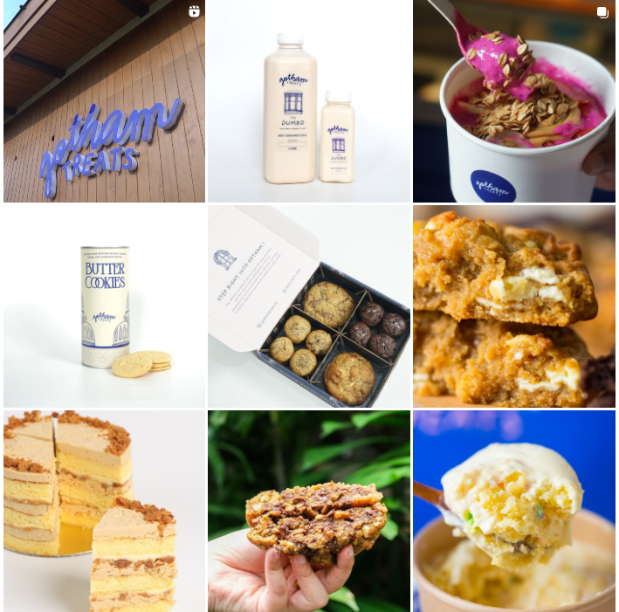
About Gotham Treats
Inspired by their love for New York City, Gotham treats is a small dessert shop nestled in the heart of South Jakarta where they create their own our take on the American classic sweets.
Their sweets are baked fresh and made with the utmost care in small batches. Their products include cookies, puddings, milks and pies.
20+ Employees
Retail Industry: Bakeshop

Slide 3
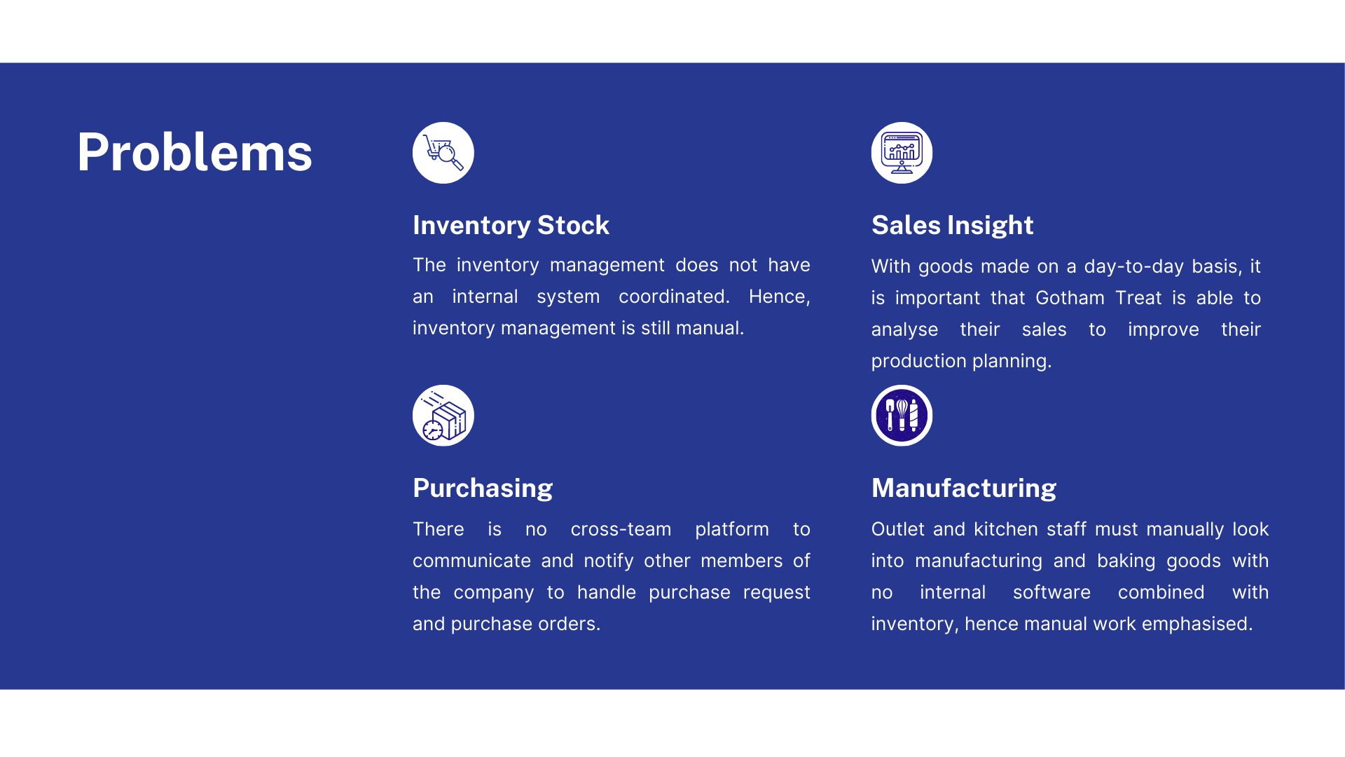

Slide 4
Operation Procedure

Slide 6
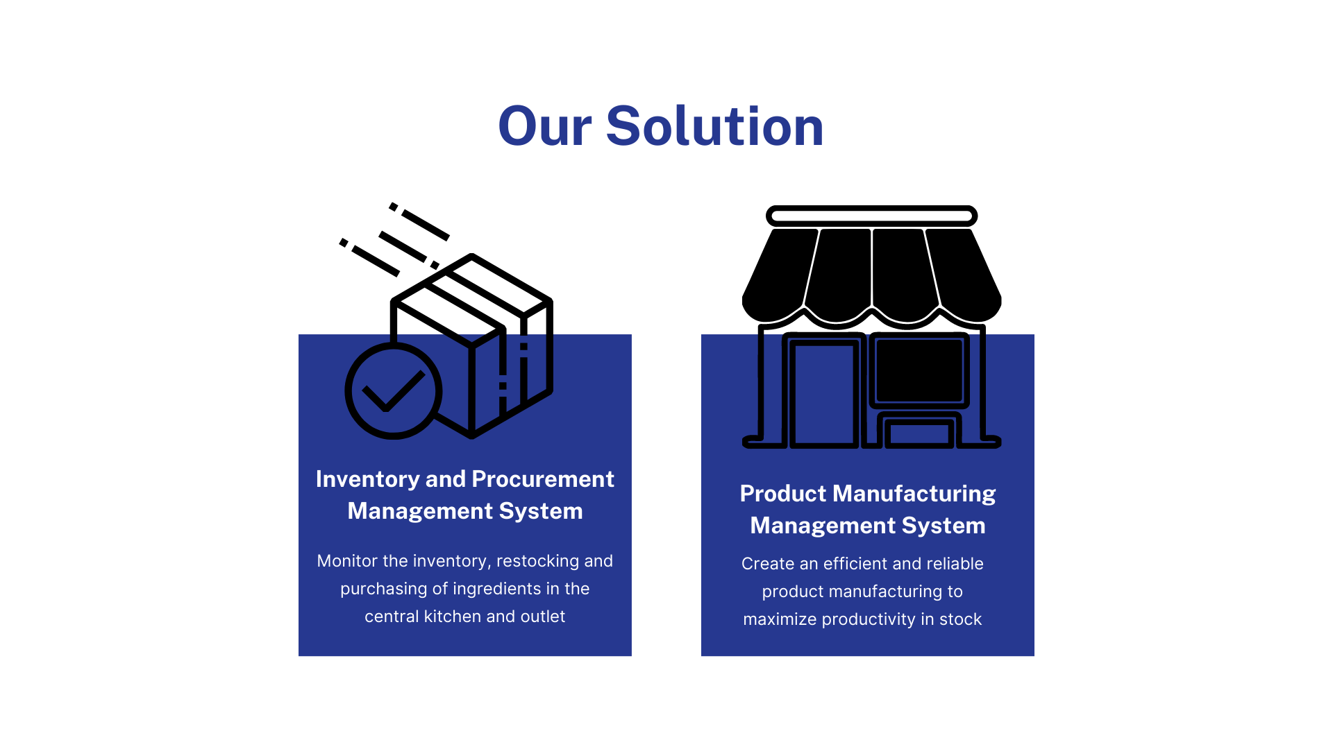

Slide 7
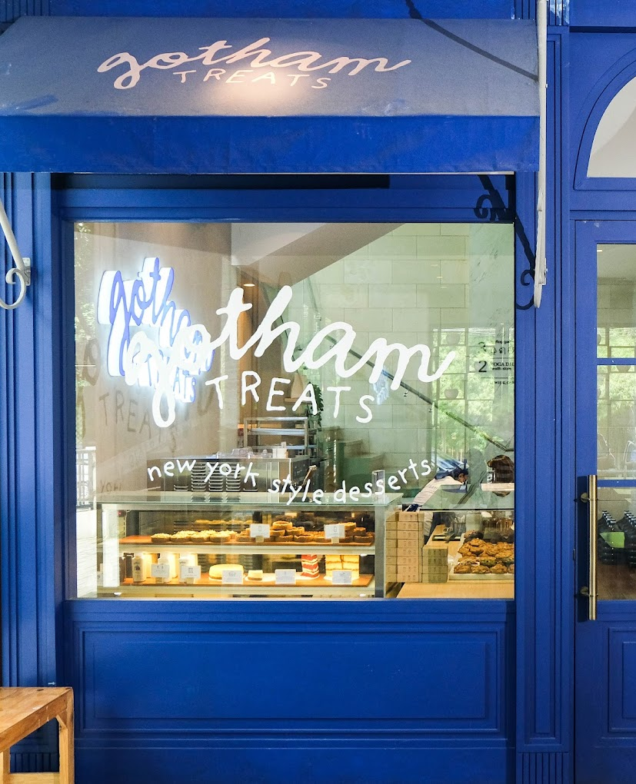
Table of Contents
Value Analysis and Proposition
Deliverable Structure Chart
Drivers and Triggers
Process Selection Matrix
End to End
Use Case Diagram
Multilayer + First Cut
Revised Cut Class Diagram
UI/UX

Slide 8
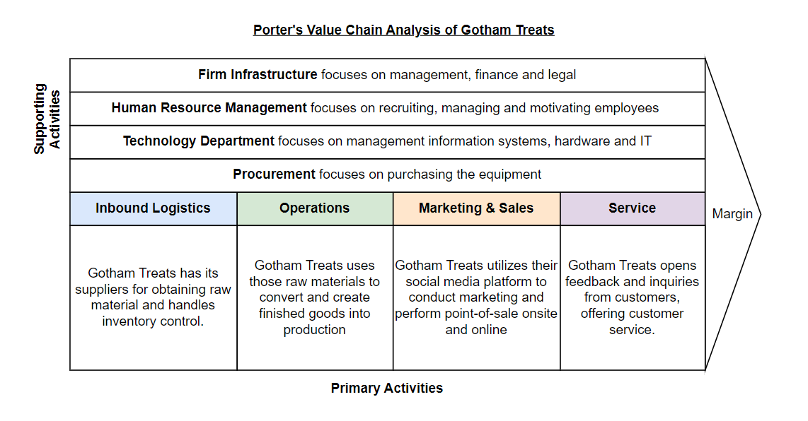
Value Analysis

Slide 9
Value Proposition
 | Operational Excellence | Product Leadership
Core Business Processes | With high customer demand, there is need to match with the supply | Create innovative products (flavors and bakeshop items) and explore the reach and sales in the market
Organization and Structure | There is a central authoritative with power, mainly the co-founders and the managers are in power | The organization structure is organic and loose
Management Systems | There is standard operating procedure to ensure high quality is achieved. | Through product innovation, risk can be expected and it rewards people for innovation and creativity in its products.
Culture: Mindsets and Behaviour | The focus is on making the system effective and efficient | The focus is on innovating and creating a breakthrough in the market.

Slide 10
Process Selection Matrix

Slide 11
End to End

Slide 12
Activity Diagram

Slide 13
Use Case Diagram

Slide 14
Process Cycle

Slide 15
RACI

Slide 16
Class Diagram

Slide 17

Head of Operations
Responsibilities:
Decide on the make to stock quantity per day for each product every month for material requirement planning
Evaluate each incoming purchase request and send purchase order to vendor through form.
View quality control report once purchase order has arrived.
Submit payment request once purchase order is satisfied.
Notes:
NICHO JELASIN

Slide 18
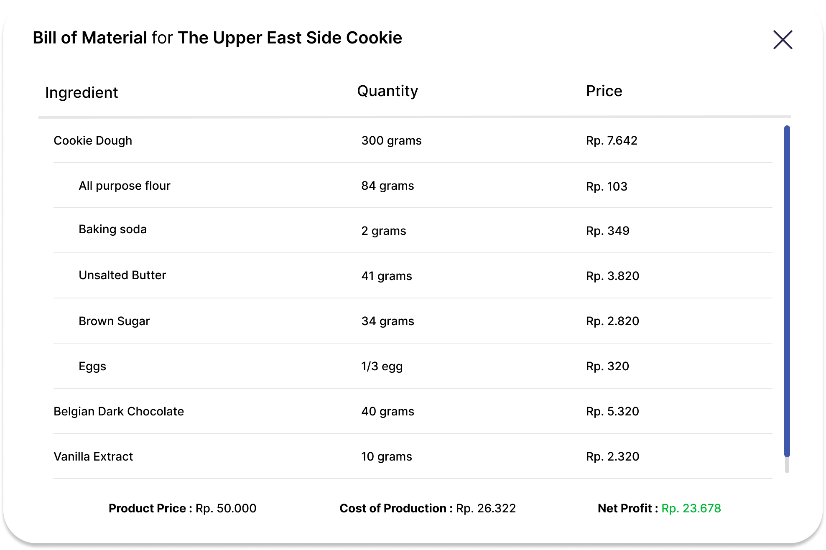
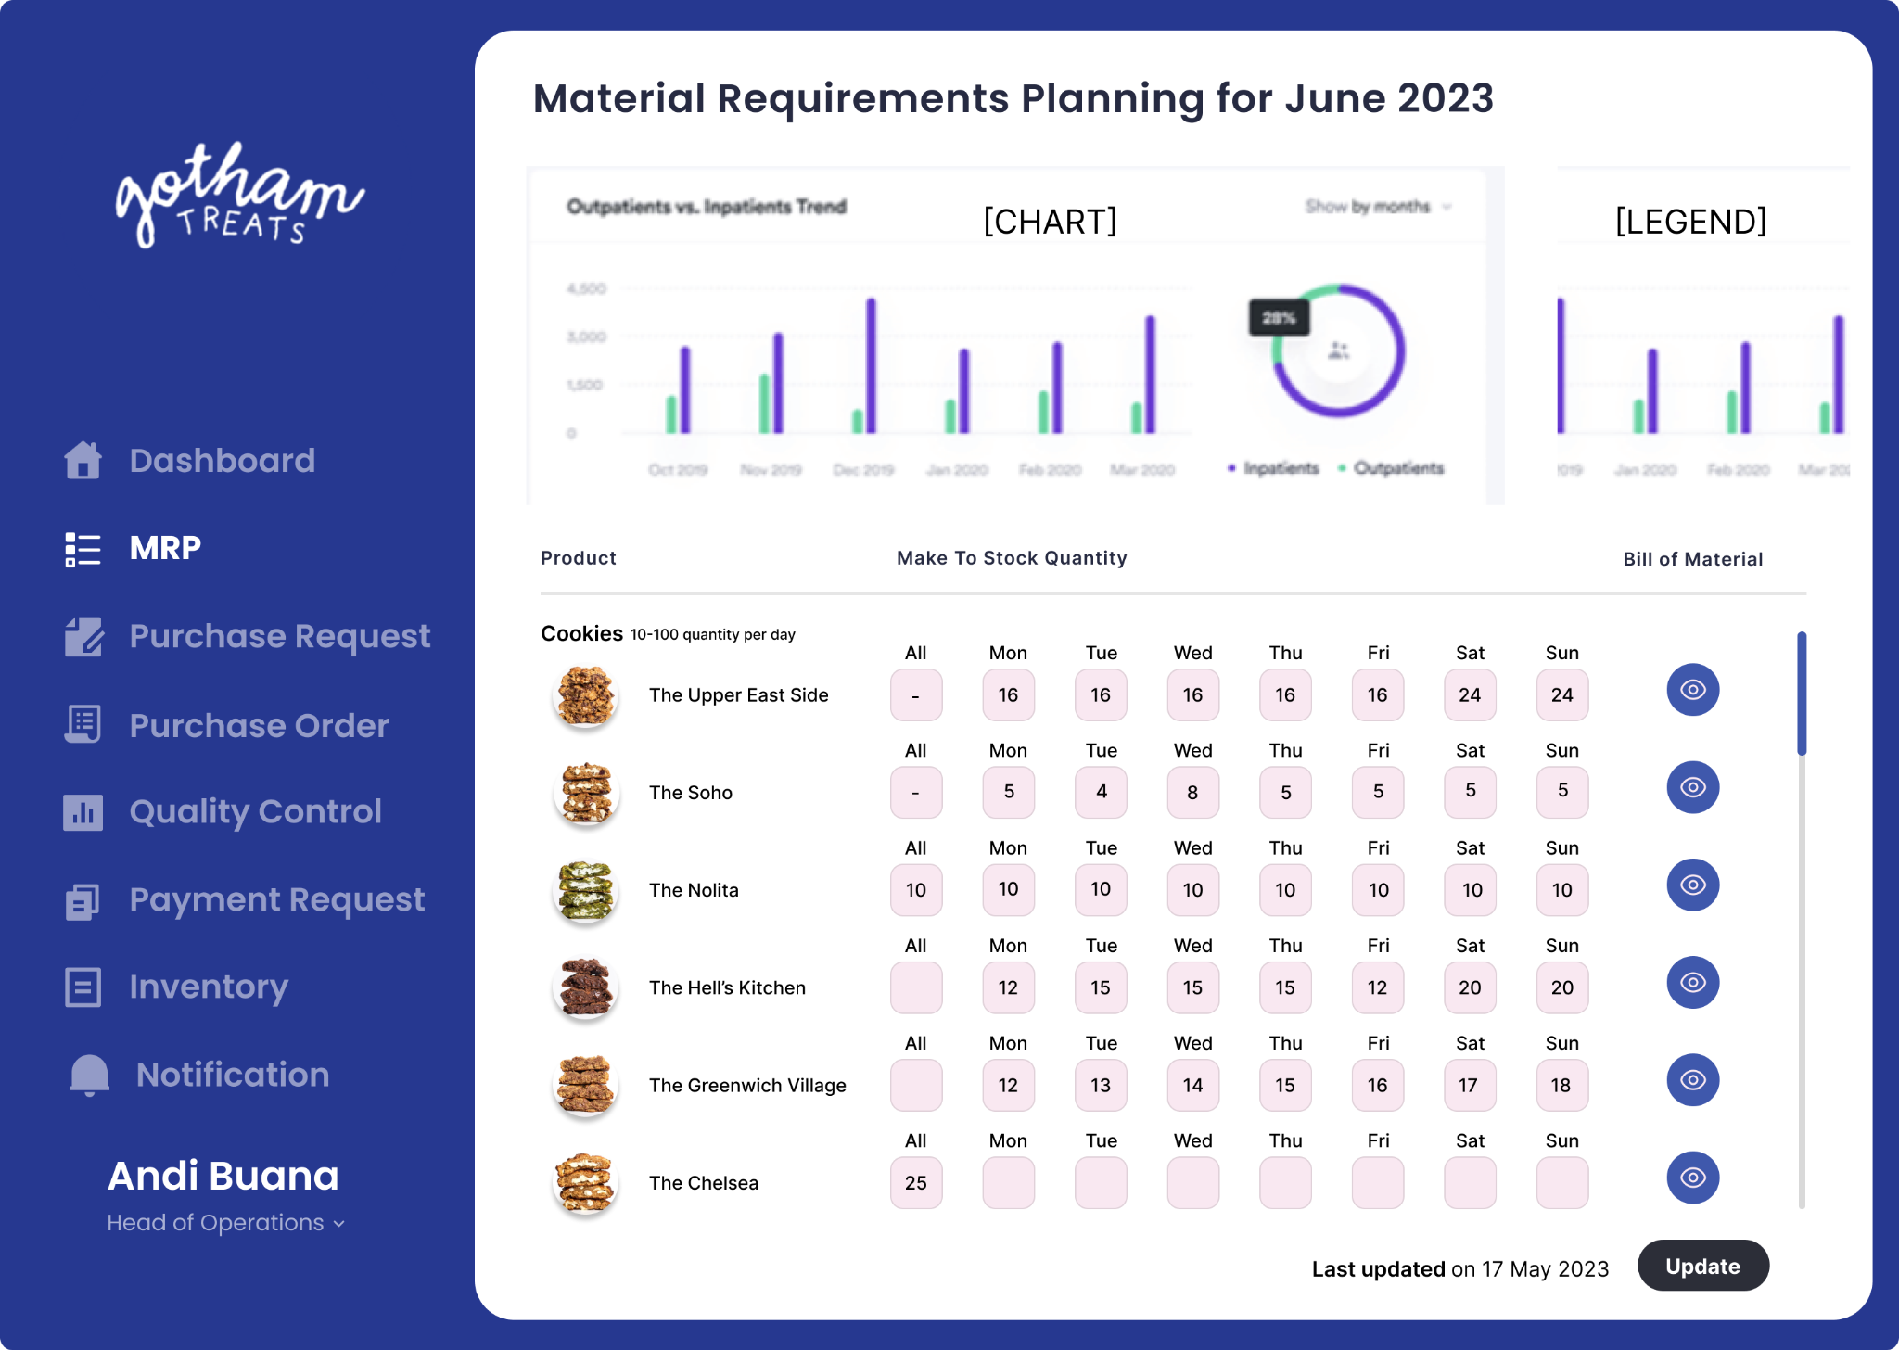
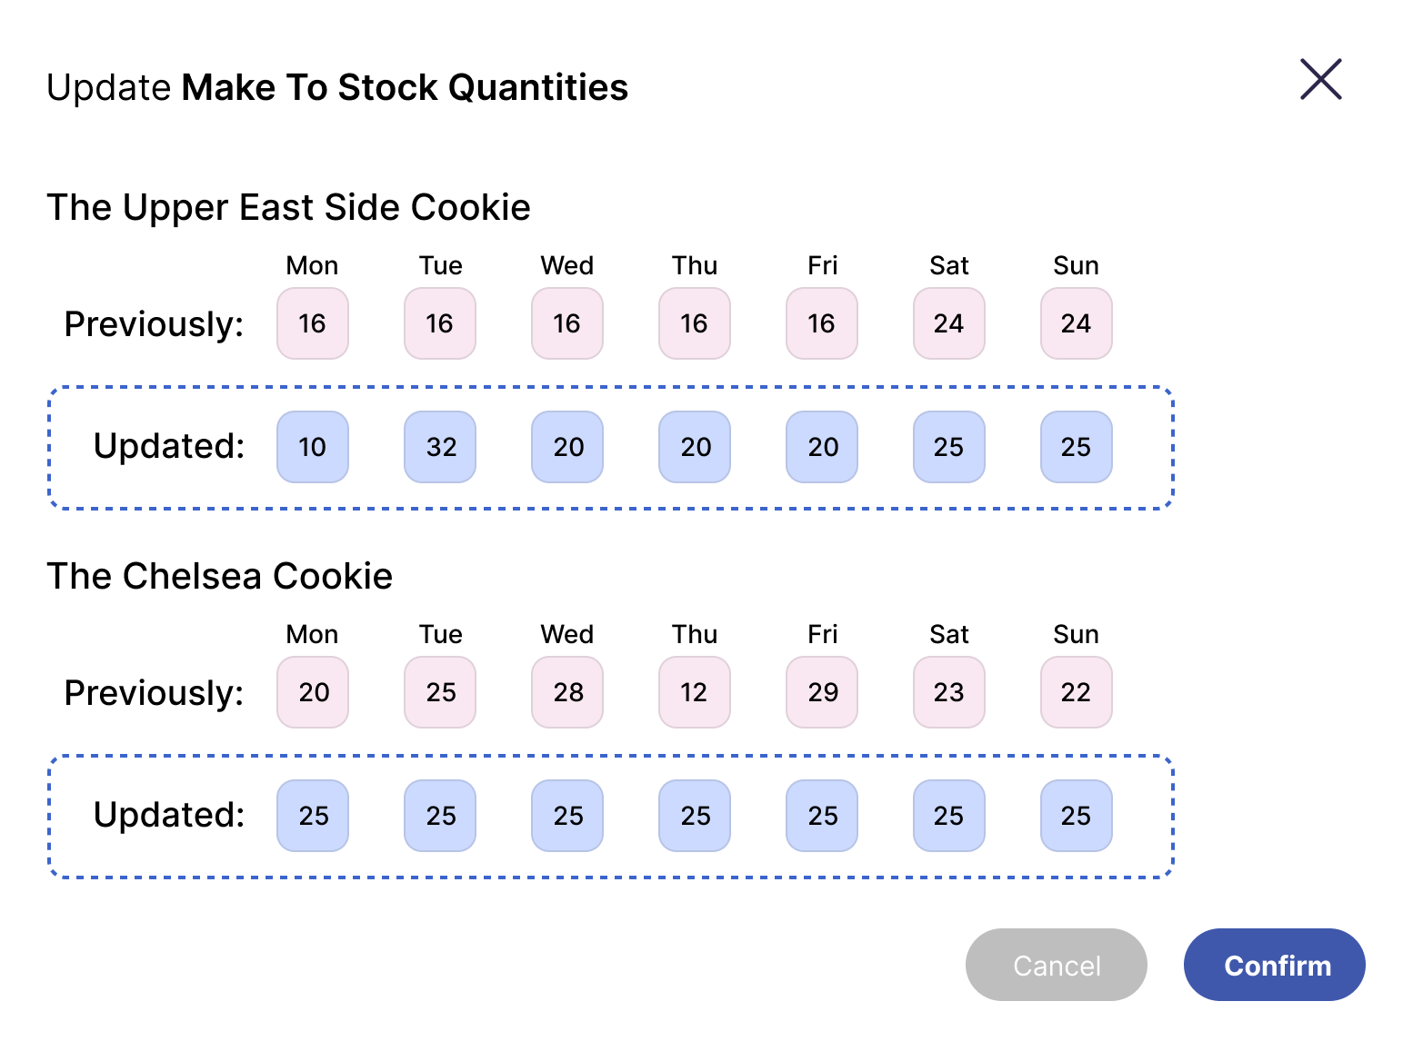
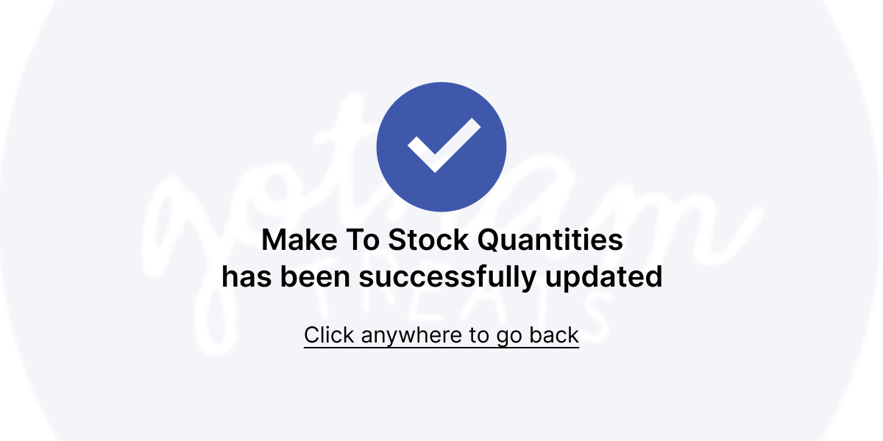
Head of Operations
Material Requirements Planning UI

Slide 19

Purchasing Staff
Responsibilities:
Handles evaluating purchase Evaluate each incoming purchase request and send purchase order to vendor through form
Submit payment request once purchase order is satisfied

Slide 20
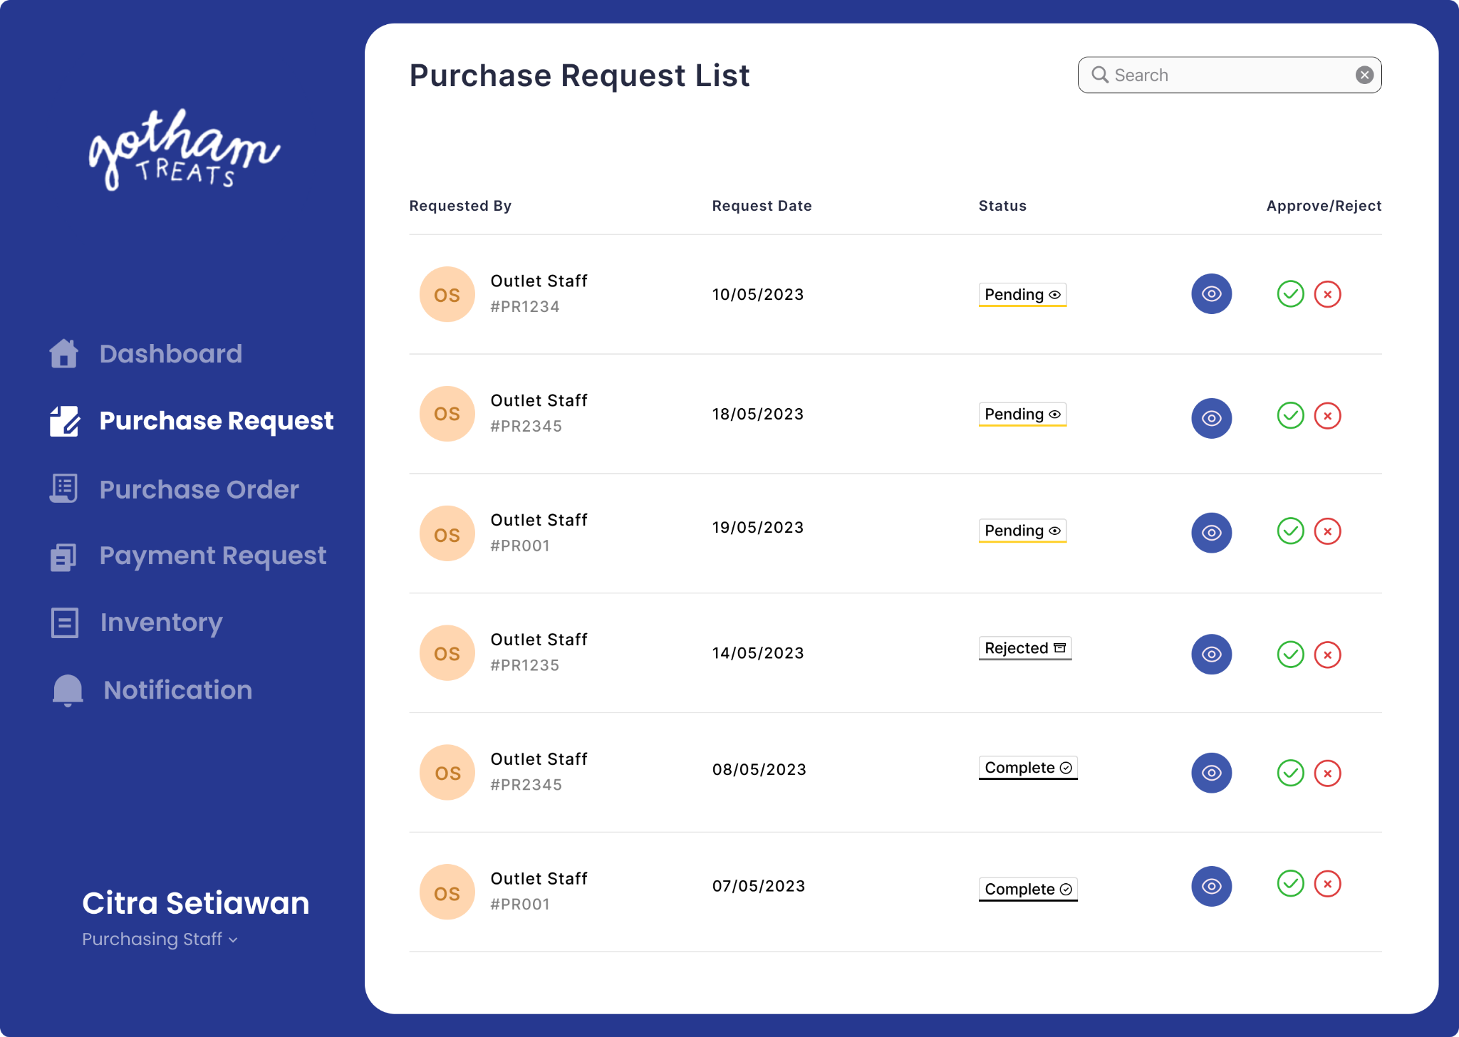
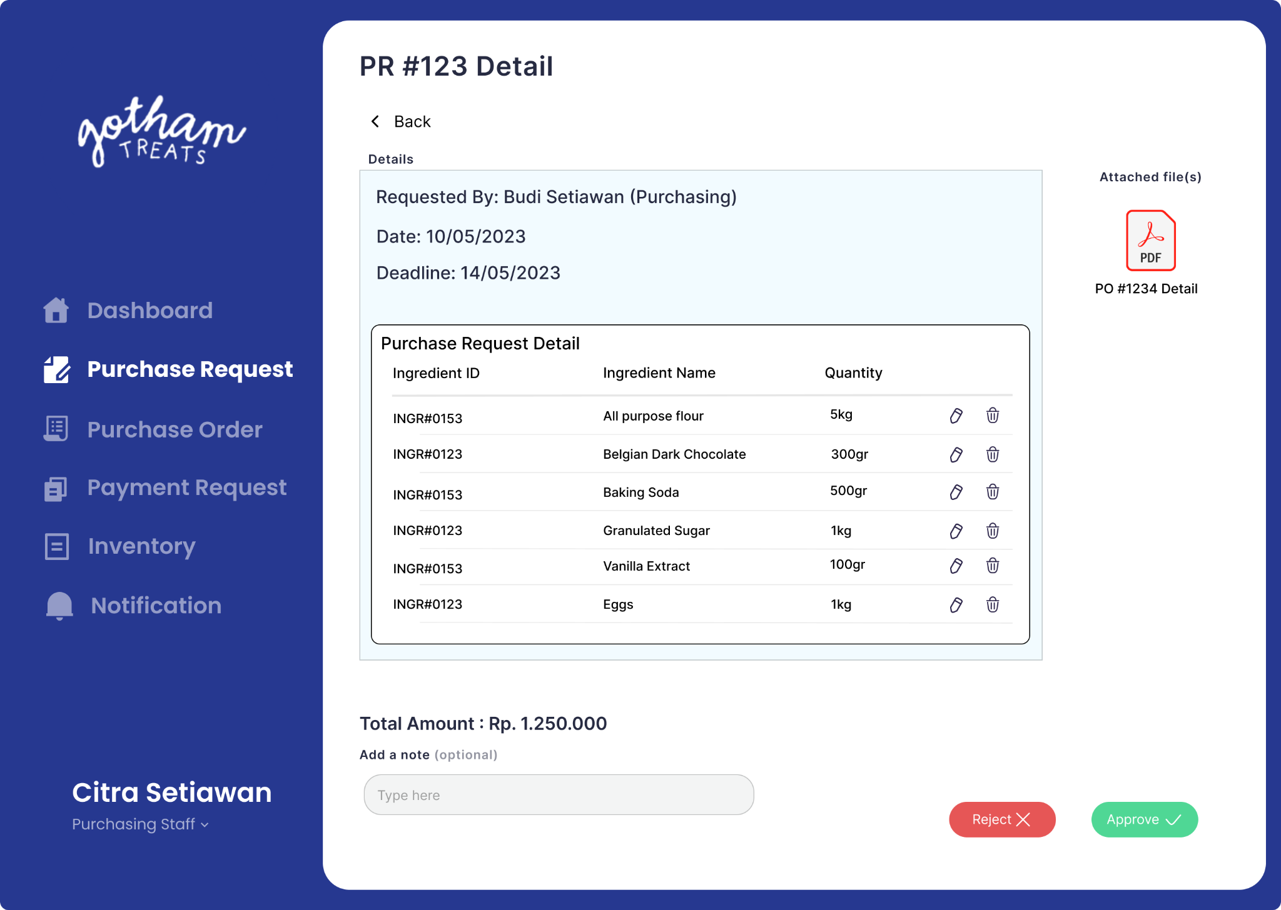
Purchasing Staff
Purchase Request List UI
Purchase Request Detail UI

Slide 21

Kitchen Staff
Responsibilities:
Update status and arrival of the items according to the purchase order
Submit quality control report after purchase order item has been arrived into the central kitchen
Create and monitor delivery list to track delivery items (inventory goods) and location from kitchen to outlet
Manage goods inventory

Slide 22
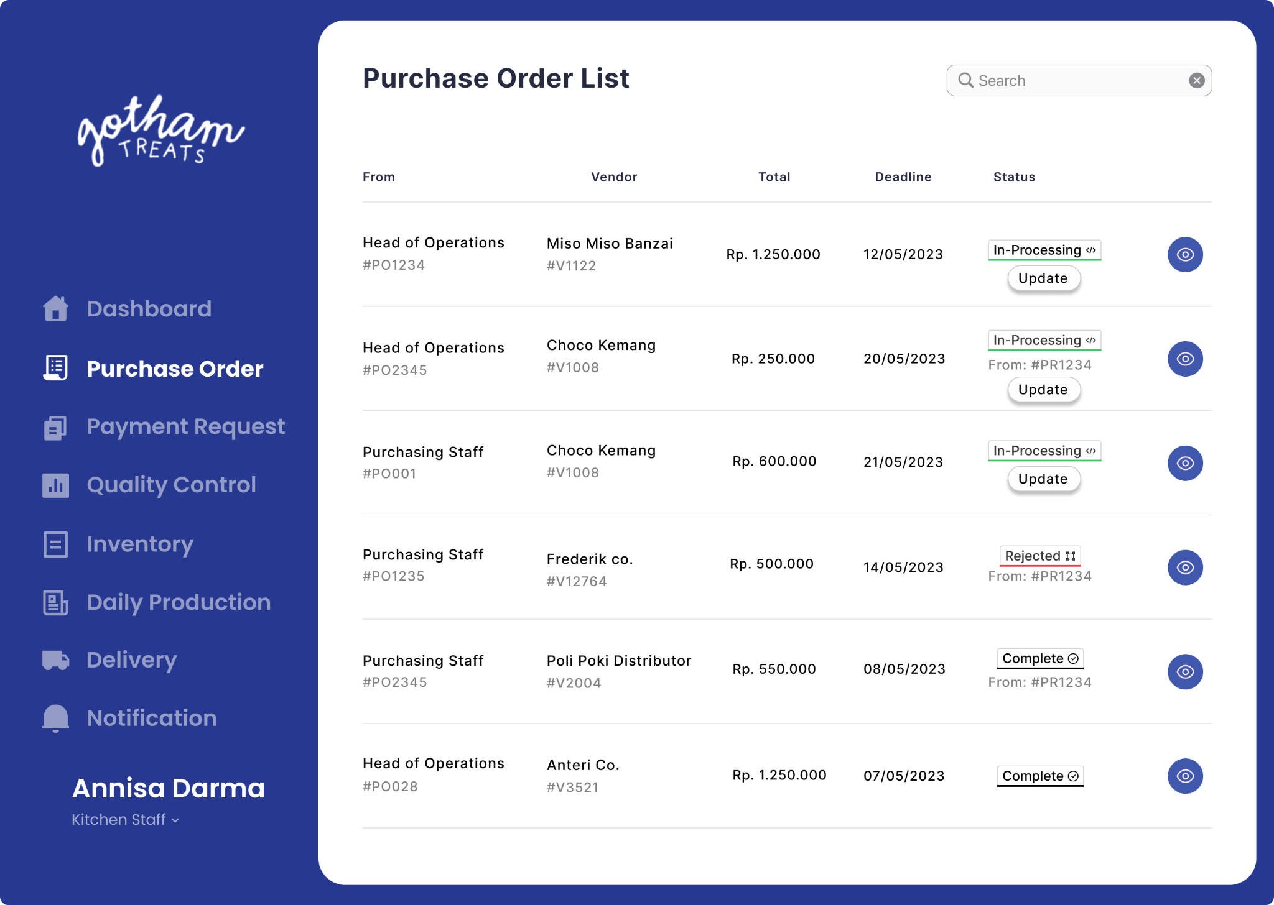
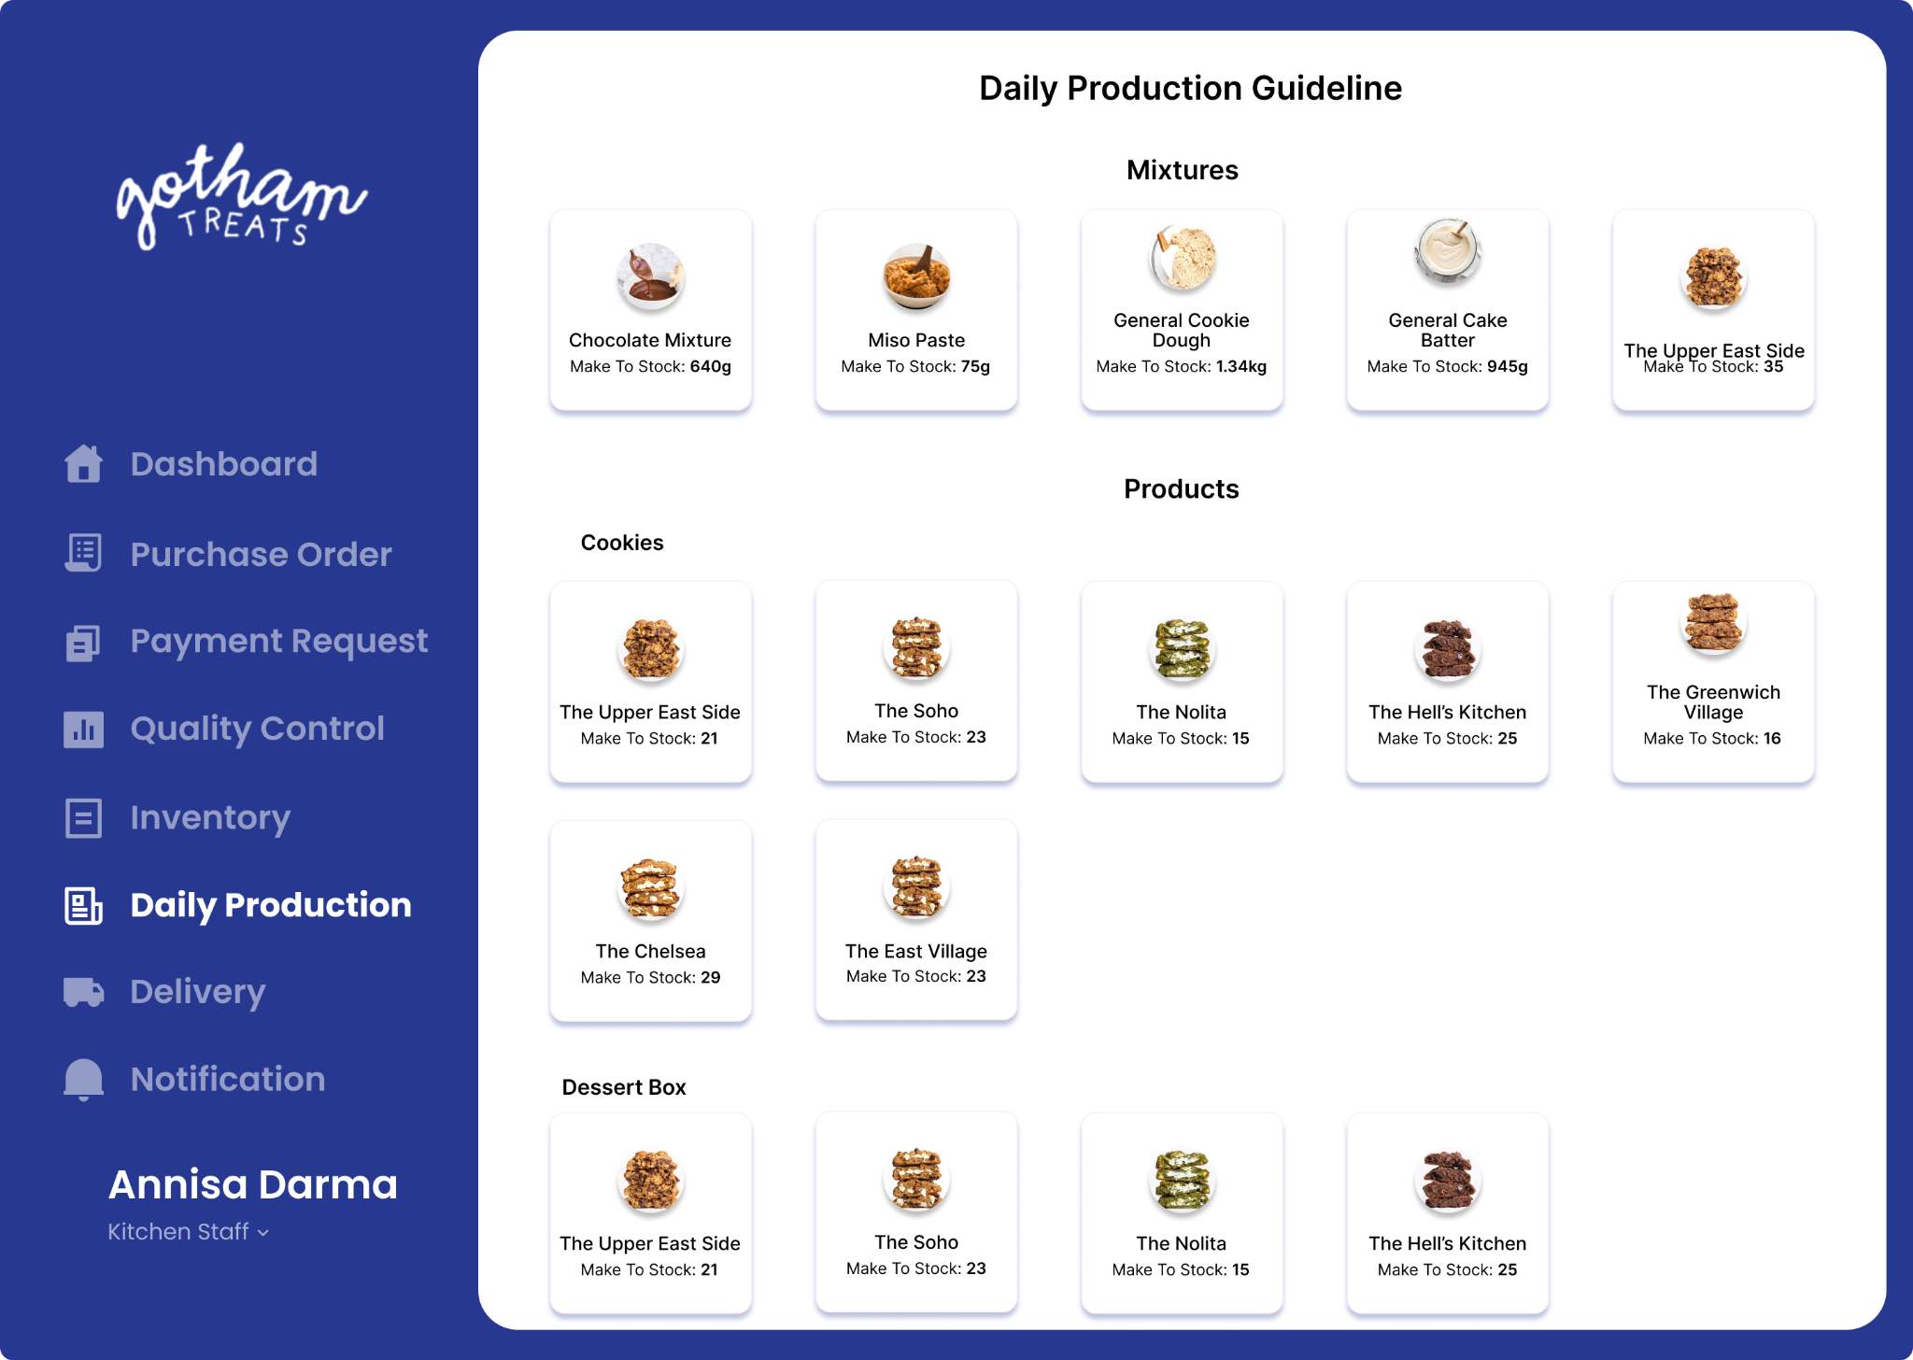
Kitchen Staff
Purchase Order List UI
Daily Production Guideline UI

Slide 23

Outlet Staff
Responsibilities:
When an incoming bulk order is made, they need to submit a purchase request
Once purchase order is approved, they are able to submit payment request and view its details including status
Outlet staff are able to view production planning and manage their current inventory
With an incoming delivery of ingredients, they are able to monitor and keep up-to-date with delivery

Slide 24

Finance Staff
Responsibilities:
Evaluate the incoming payment request and do the necessary transactions
Handle and execute the transaction and invoice
Update the payment request status accordingly

Slide 25
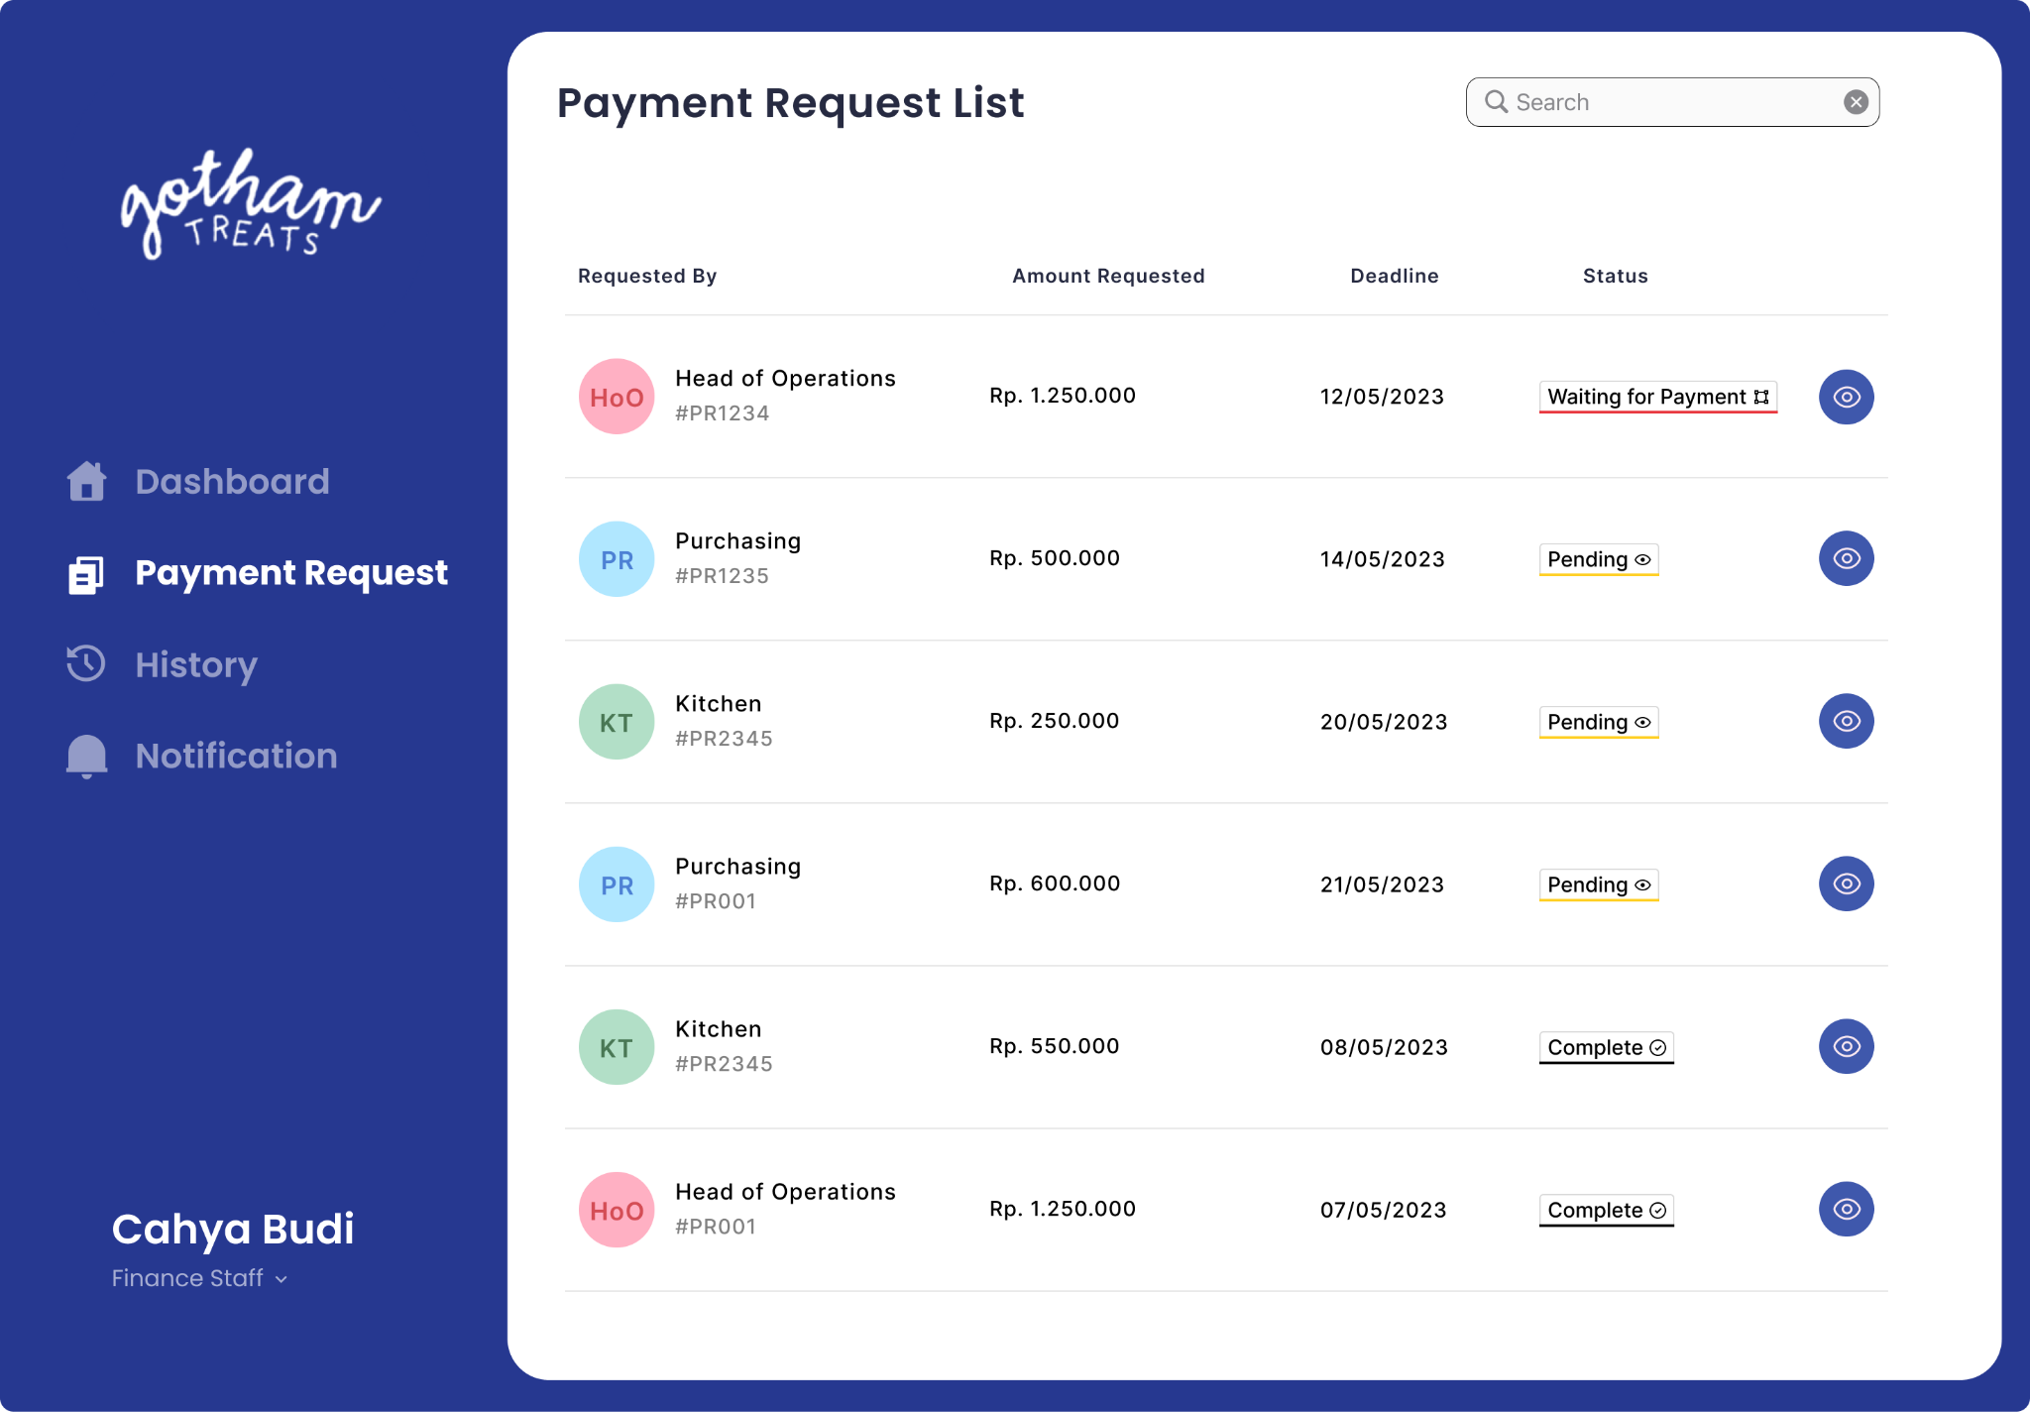
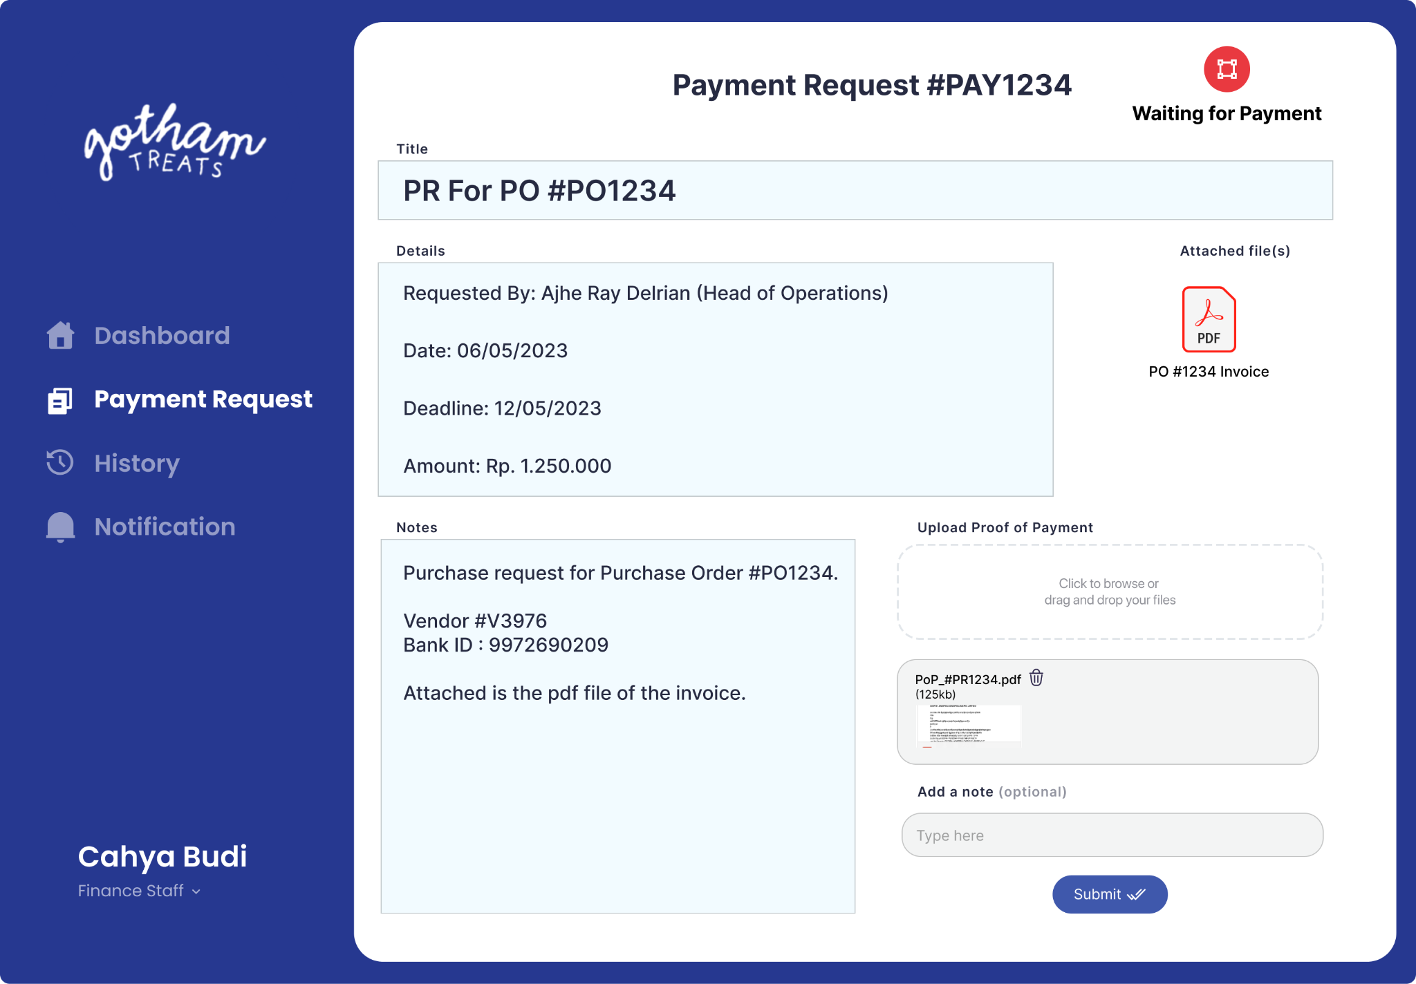
Finance Staff
Payment Request List UI
Payment Request Detail UI

Slide 26
Thank you

